Slide 1
TEAM 6

Slide 2
TEAM MEMBERS
SRINIDHI
OMKAR JAGTAP
YUVATHARANI
HAMRUTHA
RUVEENA M
RAJA

Slide 3
LINUX

Slide 4
INSTALLATION

Slide 5
HARDWARE PREREQUISITE FOR INSTALLATION
Hard-disk
RAM
Graphics
Processor
Minimum → 20 GB
Recommended →50 GB
Minimum → 2 GB
Recommended → 4 GB
Minimum → Integrated Graphics.
Recommended →Higher Dedicated GPU
Minimum → 1 GHz
Recommended → A multicore processor.

Slide 6
MEDIA AVAILABLE FOR INSTALLING
USB/DVD allows you to boot into a fully functional version of Linux without installing it on your computer. Installation CD/DVD is the traditional way of installing Linux.
Virtualization allows you to run Linux as a guest operating system inside another operating system.

Slide 7
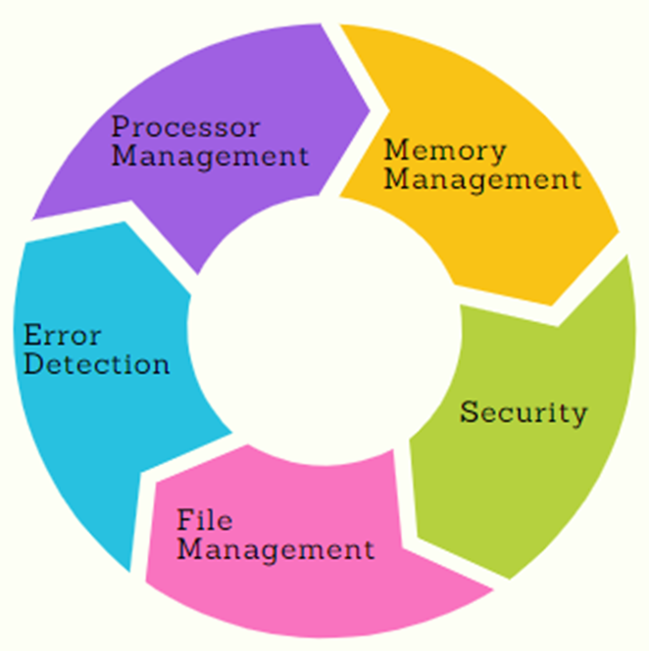
OPERATING SYSTEM
An Operating System (OS) is a program that acts as an interface between the system hardware and the user.
There are many operating systems
Microsoft’s Windows.
Apple’s macOS.
Linux.
An operating system has three main functions:
Manage the computer's resources, such as the central processing unit, memory, disk drives, and printers.
Establish a user interface.
Execute and provide services for applications software.

Slide 8
OPERATING SYSTEM INSTALLATION
Graphical User Interface (GUI) Installations
A graphical user interface (GUI) is a digital interface in which a user interacts with graphical components such as icons, buttons, and menus.
Text-Based Installations
Installation in text mode follows a pattern similar to the graphical installation.
Network Boot Installations
Network booting, shortened as netboot, is the process of booting up a computer from a network instead of a local disk.

Slide 9
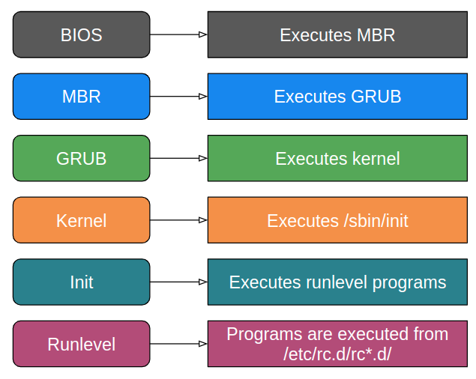
BOOTING PROCESS
Booting is the process which is initiated once the computer system starts and executes small set of instructions present in the ROM which will setup system hardware by testing them and load the operating system so that computer system can carry out further tasks.

Slide 10
USAGE OF LINUX

Slide 11
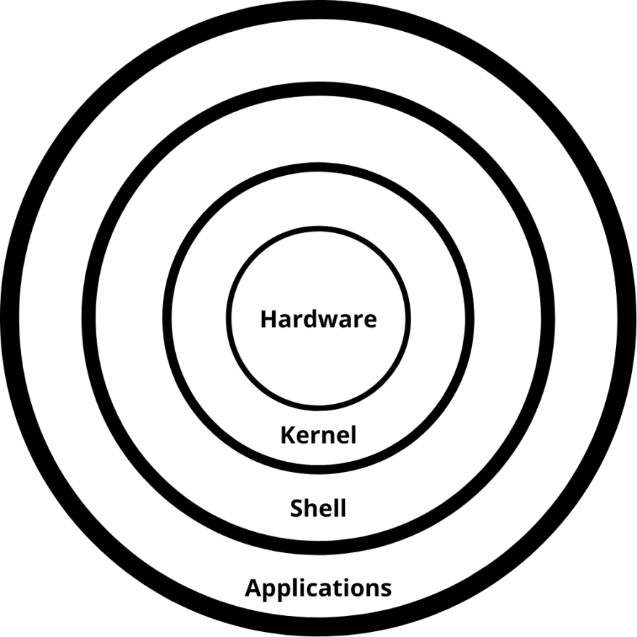
SHELL AND IT’S TYPES
Linux shell:
It is a command-line interpreter.
It is understood and interpreted by a program.
Types of Shells:
Bourne Shell - 1977
C Shell -1978
Korn Shell - 1983
Bourne-Again Shell - 1989
Z shell - 1990

Slide 12
LINUX FILE SYSTEM DIRECTORY
Root (/): top-level directory All other directories and files are organized under the root directory.
/bin: Contains essential executable binaries and commands like ls, cp, mv, etc., are located here
/boot: Contains the files required for system booting, including the kernel, bootloader configuration files, and initial RAM disk
/dev: Contains device files that represent hardware devices in the system, such as hard drives, USB devices, serial ports, etc.
/etc: Stores system-wide configuration files,contains various directories and files that control the behavior of the system, network settings, user authentication, and more.
/usr: Contains user-related programs, libraries, documentation, etc. It has subdirectories like /usr/bin (user binaries), /usr/lib (libraries), /usr/include (header files), and more.
/var: Contains variable data files, such as log files, spool files, cache files, and other temporary or frequently changing data.

Slide 13
NETWORK SERVICES & NETWORK CLIENTS

Slide 14
NETWORK SERVICES
Network services in Linux are defined as the group of applications that run in the background and enable network-based activities, like connecting to the Internet, transferring files, etc.
Three Services in Linux System
Network
iptables
xinetd

Slide 15
TYPES OF NETWORK SERVICES
Dynamic Host Configuration Protocol (DHCP)
Domain Name System (DNS)
Wide Area Network (WAN)
File Sharing
Network Time Protocol
Firewall

Slide 16

NETWORK CLIENTS
Network clients in Linux are software applications that allow users to access resources.
Uses protocols like HTTP, FTP, SSH, and Telnet to communicate with servers.
They communicate with network services running on servers to retrieve data.

Slide 17
PACKAGE MANAGEMENT

Slide 18


PACKAGE MANAGEMENT
PACKAGES :
Combining multiple files of any application or software.
Linux Packages are managed by Package Managers.
Software repositories - centralized collections of software packages that are maintained and managed by the Linux distribution
Commonly used package managers are;
RPM - Redhat Package Manager
YUM – Yellowdog Update Modified

Slide 19
RPM
It is an open-source package manager
Used to install , update and manage software packages
The most famous utility of package management for Red Hat-based systems such as Fedora, CentOS, and RHEL.
YUM
YUM simplifies the process of installing, updating, removing, and managing software packages.
YUM installs packages from repositories in the system.
Yum replaced by ‘dnf’ in new versions of distributions.

Slide 20
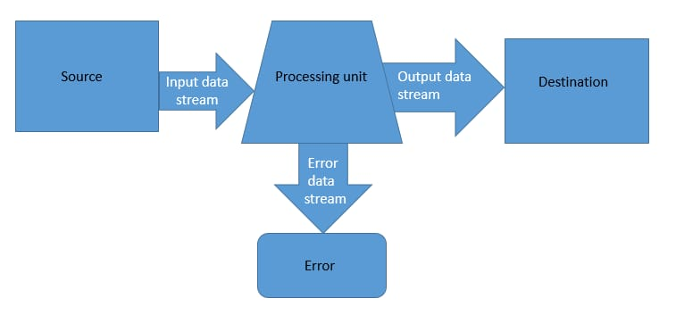
STANDARD STREAMS
In Linux and computer programming in general, standard streams are input and output (I/O) communication channels between a program and it's environment.
The Three standard streams are
standard input (stdin)
standard output (stdout)
standard error (stderr)

Slide 21
PIPE
Stream of data that runs between two processes that are either closely related or have no common origin.
The vertical bar ( | ) represents this operator.
Standard input STDIN works between the source and the processing unit. The source provides the data and the processing unit receives and processes the data. Standard output The processing unit processes the command and loads the output of the command in STDOUT or output data stream. Standard error STDERR or error data stream handles error.

Slide 22

LINUX APACHE
Apache is actually a web server software, and it's often referred to as "Apache HTTP Server".
Open-source web server software that serves web content to clients over the internet.
Used to host websites and web applications
Apache’s configuration is defined in text-based files like ‘httpd.conf’.
Runs on various platforms ,not just Linux
Hosts multiple websites on a single sever through virtual hosts.

Slide 23
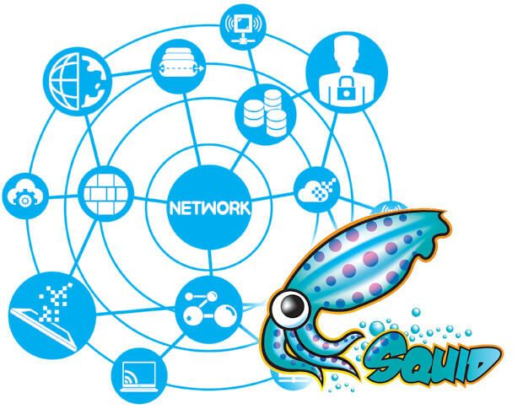
SQUID - Robust server which supports caching for protocols
High speed accessed websites
It uses two NICs as internal and external
Port number of SQUID -3128
Address where Squid listens for client requests over TLS/SSL connections are HTTPS.
LINUX SQUID PROXY

Slide 24

MAIL
The Mail components are,
MUA
MTA
MDA
IMAP
POP3
SMTP
LINUX MAIL SERVICES
Postfix is a free and opensource MTA (Mail Transfer Agent) used for routing or delivering emails on a Linux system.
Known for its security features ,ease of configuration and performance.

Slide 25
NETWORK FILE SHARING SERVICES

Slide 26
NETWORK FILE SHARING
Network File Sharing (NFS) is a protocol that allows you to share directories and files with other Linux clients over a network.
Shared directories are typically created on a file server, running the NFS server component.
Users add files to them, which are then shared with other users who have access to the folder.

Slide 27
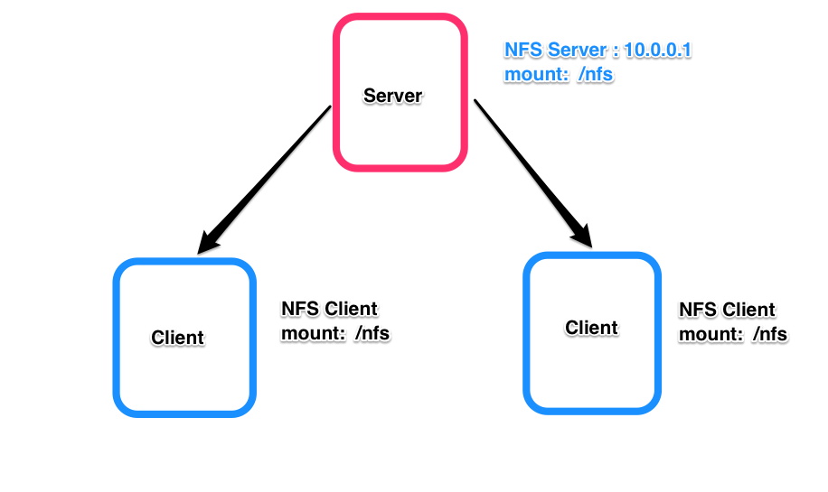
BENEFITS OF NFS:
Efficient resource utilization.
Centralized data storage and management.
Simplified data sharing among Linux/UNIX systems.
BASIC COMPONENTS OF NFS:
NFS Server: The system exporting the directory.
NFS Client: The system mounting and accessing the shared directory.

Slide 28
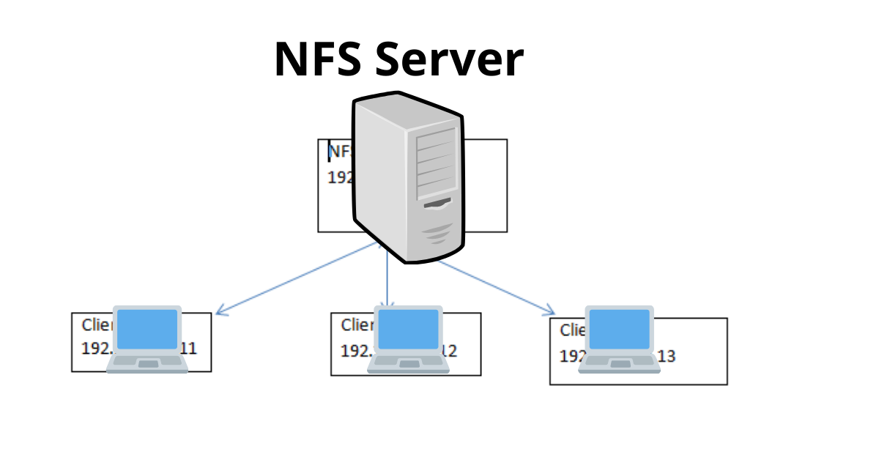
NFS CONFIGURATION AND USAGE:
Setting Up NFS:
Installing NFS server components (nfs-kernel-server package).
Configuring shared directories in /etc/exports file.
Mounting NFS Shares:
Installing NFS client components (nfs-common package).
Mounting remote NFS shares using the mount command.
Use Cases:
Home network file sharing.
Centralized user home directories in an enterprise.
Distributed application deployments.

Slide 29
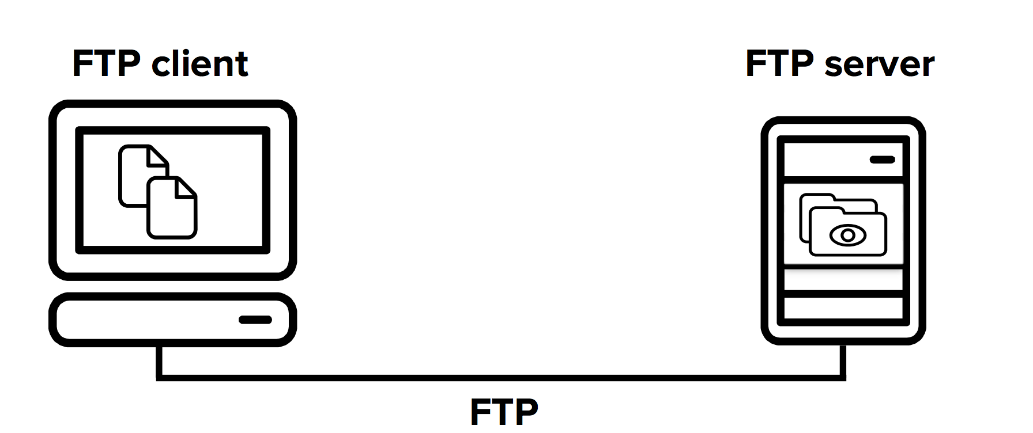
FILE TRANSFER PROTOCOL(FTP)
The File Transfer Protocol is a standard communication protocol used for the transfer of computer files from a server to a client on a computer network.

Slide 30
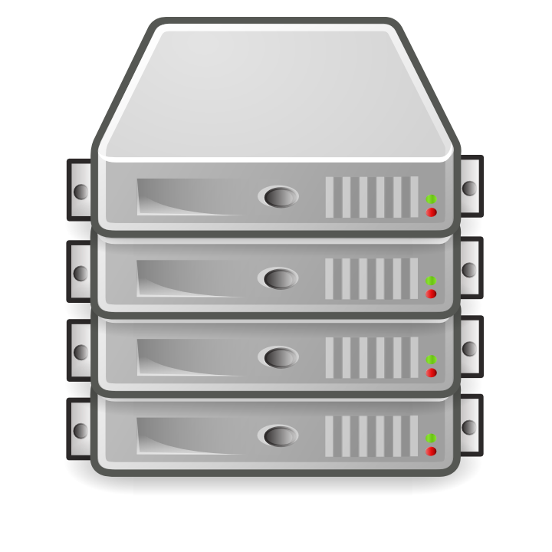
Installation
Server :
yum install vsftpd
Client:
Yum install ftp
Server FTP setup:
Config changes
/etc/vsftpd/vsftpd.conf
anonymous_enable=NO
Uncomment
ascii_upload_enable=YES
ascii_download_enable=YES
May add
Use_localtime=YES

Slide 31

SAMBA
Samba allows for Windows and other clients to connect to file share directories on Linux hosts. It implements the server message block (SMB) protocol.
Installation
# Yum install –y samba

Slide 32
Configuration
Adding user:
# useradd sambashare
#passwd ********
#setfacl –m u:sambashare:rwx /sambashare
Add path and allow in configuration file:
# vi /etc/samba/smb.conf
#testparm

Slide 33
Allow Firewall
#Firewall-cmd –permenant –add-service=samba
Enable samba service:
#systemctl enable smb
Restarting the samba service:
#systemctl restart smb

Slide 34
AZURE - I

Slide 35
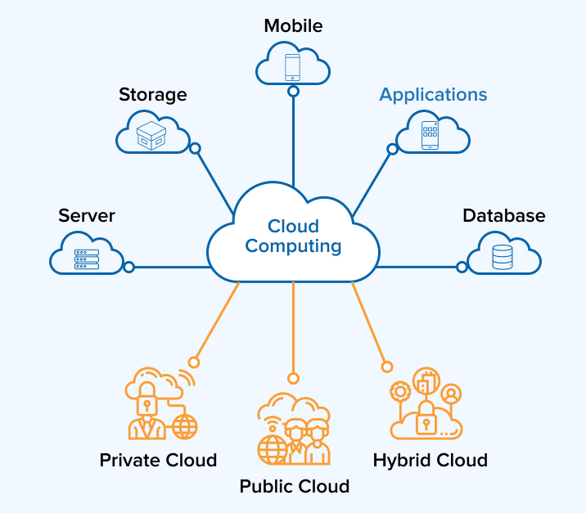
CLOUD
The cloud is a distributed collection of servers that host software and infrastructure, and it is accessed over the Internet.
TYPES:
Private cloud
Public cloud
Hybrid cloud

Slide 36
AZURE
Azure, is Microsoft's public Cloud computing platform. It provides a broad range of cloud services, including compute, analytics, storage and networking.
ADVANTAGES:
FLEXIBILITY
SECURITY
SCALABILITY
COST SAVING

Slide 37
IDENTITY AND GOVERNANCE:
AZURE ACTIVE DIRECTORY:
Azure Active Directory is Microsoft's cloud-based identity and access management service.
AZURE SUBSCRIPTION:
An Azure subscription is a logical container used to provision and manage Azure resources.
ROLE-BASED ACCESS CONTROL (RBAC):
Role-Based Access Control (RBAC) is a fundamental security feature in Microsoft Azure that allows you to manage access to Azure resources.

Slide 38
AZURE – ADMINISTRATION
CLOUD SHELL :
Azure Cloud Shell is an interactive, authenticated, browser-accessible terminal for managing Azure resources.
AZURE POWERSHELL AND AZURE COMMAND-LINE INTERFACE :
Azure PowerShell and Azure Command-Line Interface (CLI) are two powerful command-line tools provided by Microsoft for managing and automating Azure resources and services.

Slide 39
AZURE – NETWORKING AND SECURITY
AZURE FIREWALL AND KEY VAULT:
Azure Firewall is a cloud-native and intelligent network firewall security service that provides the best of breed threat protection for your cloud workloads running in Azure.
Microsoft Azure Security Center is a set of tools for monitoring and managing the security of virtual machines and other cloud computing resources within the Microsoft Azure public cloud.
AZURE SECURITY CENTER
Azure DNS is a hosting service for DNS domains that provides name resolution by using Microsoft Azure infrastructure.
AZURE DNS

Slide 40
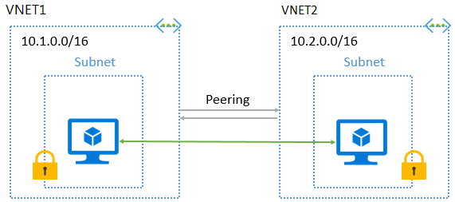
AZURE – INTERSITE CONNECTIVITY:
VNET:
An Azure Virtual Network (VNet) is a network or environment that can be used to run VMs and applications in the cloud.
VNET PEERING :
Connecting virtual networks within the same Azure region.

Slide 41
AZURE - II

Slide 42
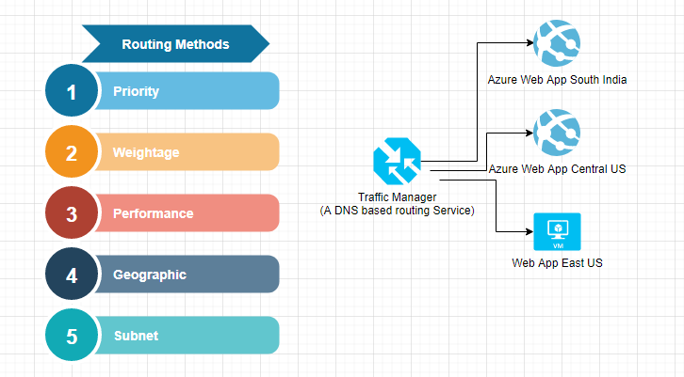
AZURE – NETWORK TRAFFIC MANAGEMENT
Azure Traffic Manager is a DNS-based traffic load balancer which allows you to distribute traffic to your public facing applications across the global Azure regions.
Major factors :
Servers/Services
Data Requests
Traffic Management System
Load Balancing
Monitoring

Slide 43
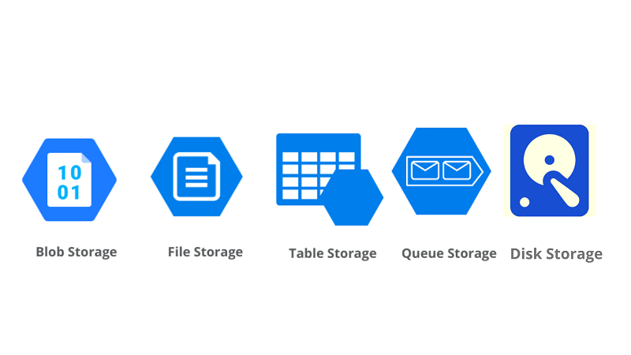
AZURE - STORAGE
Azure Storage is a cloud storage solution for modern data storage scenarios .
Azure Storage Services :
Azure Blob Storage (Azure Blobs)
Azure File Storage (Azure Files)
Azure Queue Storage (Azure Queues)
Azure Table Storage (Azure Tables)
Azure Disk Storage (Azure Disks)

Slide 44
AZURE – VIRTUAL MACHINES
Azure Virtual machine will let us create and use virtual machines in the cloud as Infrastructure as a Service.
Configuration choices :
Operating system (Windows and Linux)
VM size, which determines factors such as processing power, how many disks we attach etc.
The region where VM will be hosted
VM extension, which gives additional capabilities such as running anti-virus etc.
Compute, Networking, and Storage elements will be created during the provisioning of the virtual machine.

Slide 45
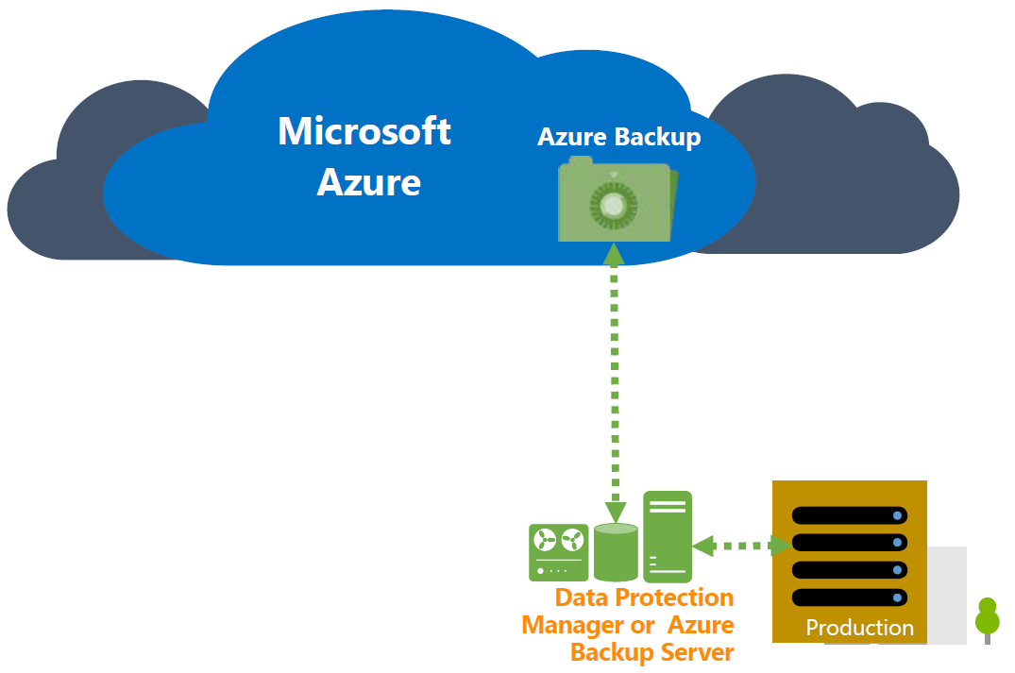
AZURE – DATA PROTECTION
Data protection in Azure involves implementing a range of measures to secure and safeguard your data hosted on Microsoft's Azure cloud platform.
Key aspects for Data Protection :
Encryption
Azure Key Vault
Azure Active Directory (Azure AD)
Role-Based Access Control (RBAC)
Firewalls and Network Security
Azure Disk Encryption
Monitoring and Auditing

Slide 46
AZURE – SERVERLESS COMPUTING
Serverless computing in Azure refers to a cloud computing model where you can build and run applications without having to manage the underlying infrastructure.
Azure provides a serverless platform known as Azure Functions, which allows developers to focus on writing code and creating functionalities without worrying about provisioning, scaling, or maintaining servers.
Azure Functions:
Azure Functions is a serverless compute service that enables you to run code in response to events or triggers without needing to manage servers.

Slide 47
AZURE – SERVERLESS COMPUTING
KEY AZURE FUNCTIONS :
Event-Driven Execution - HTTP requests, messages in a queue, changes in a database .
Stateless Execution - Scalability and simplifies management.
Auto-Scaling - Automatically scales out to handle incoming requests based on demand.
Pay-As-You-Go Pricing - Pay only for the compute resources consumed during the execution of your functions, which can result in cost savings compared to traditional infrastructure.
Triggers and Bindings - Bindings to connect functions to data sources.
Integration - Azure Functions can be easily integrated with other Azure services .

Slide 48
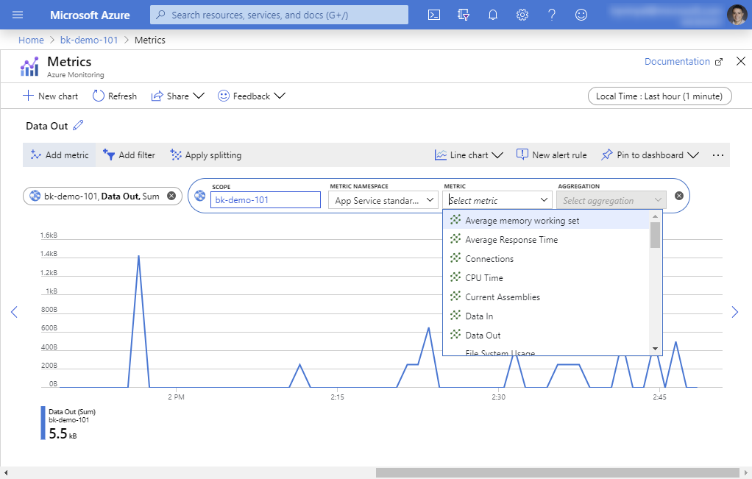
AZURE – MONITORING
Azure Monitoring helps you proactively identify and address issues, optimize performance, and ensure the reliability of your applications.
Key Components of Azure Monitoring :
Azure Monitor
Azure Application Insights
Azure Log Analytics
Azure Service Health
Azure Alerts
Azure Diagnostics

Slide 49
DEVOPS
5

Slide 50
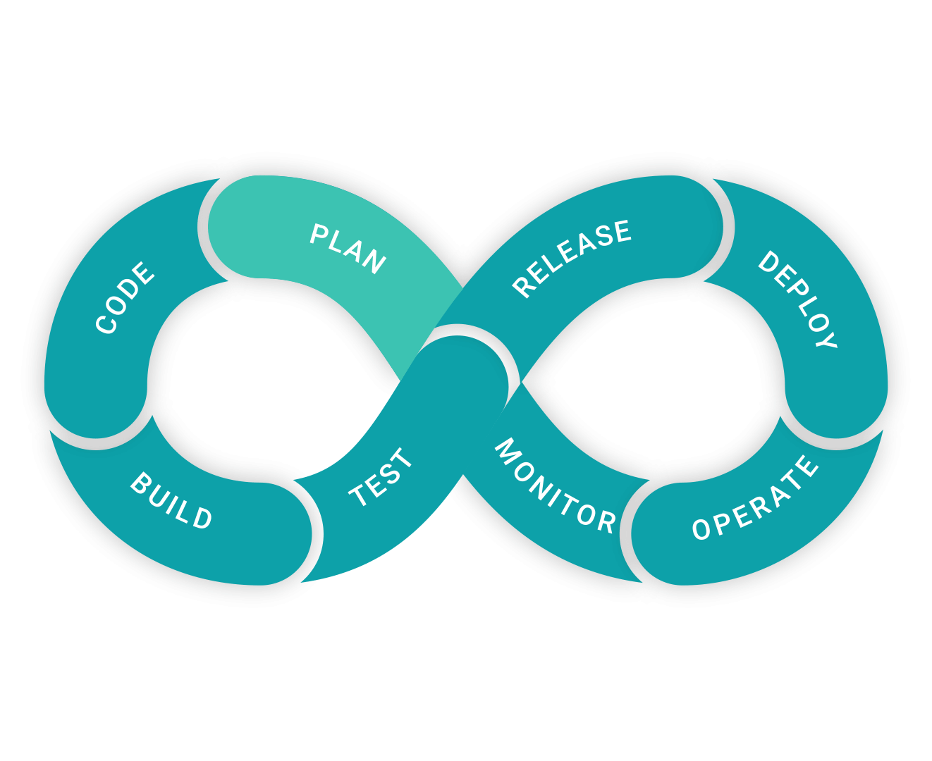
INTRODUCTION TO DEVOPS
DevOps is a collaboration between development and operations teams.
Goals include faster releases, frequent updates, and better quality.
Benefits encompass improved communication, reduced errors, and increased efficiency.

Slide 51
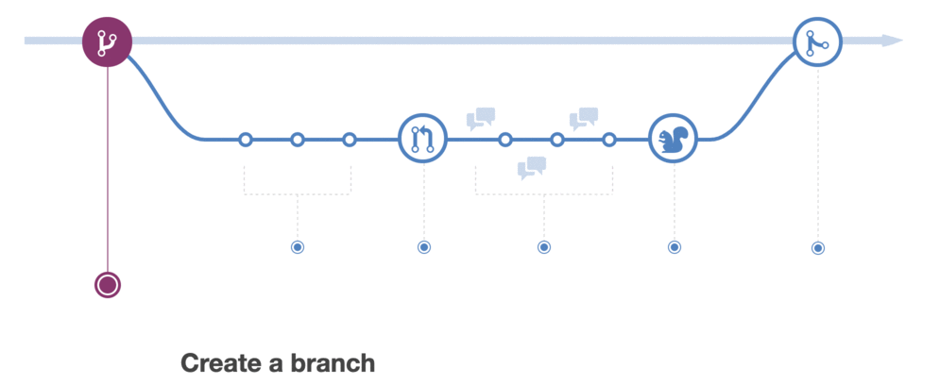

GIT
Git is a distributed version control system.
Developers collaborate on a codebase with repositories.
Version control concepts include commits, branches, and merges.
ANSIBLE
Ansible automates IT tasks and follows Infrastructure as Code (IaC) principles.
Playbooks define automation tasks using YAML.
Roles organize tasks and allow reuse across playbooks.

Slide 52
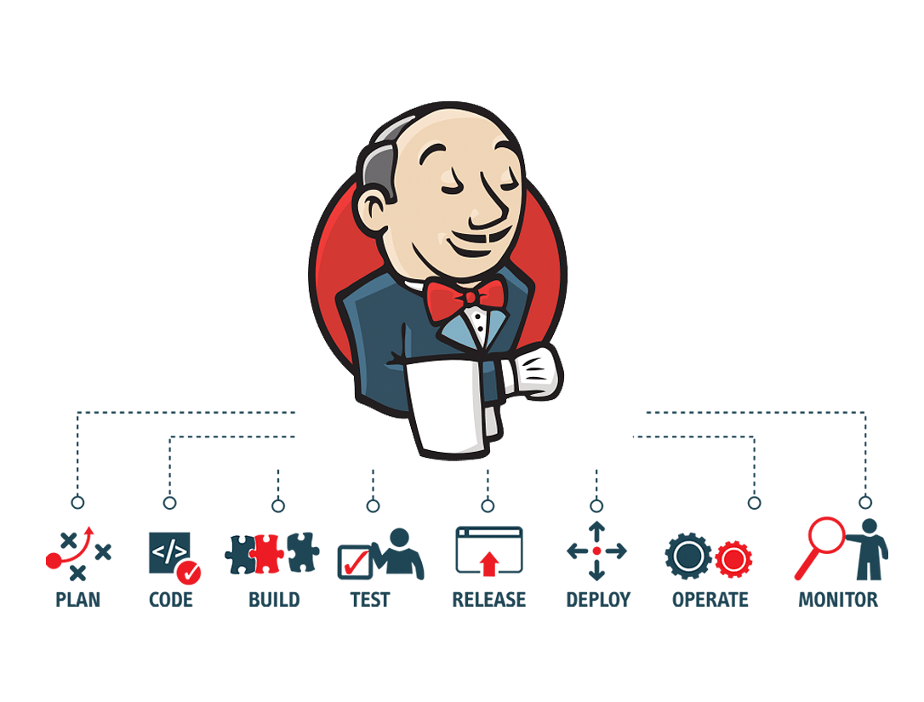
Continuous Integration and Continuous Deployment (Jenkins)
Continuous Integration (CI) integrates code changes frequently.
Jenkins automates the build, test, and deploy process.
Jenkins pipelines define the CI/CD workflow.
Continuous Deployment automates the deployment process Jenkins pipelines extend CI to include CD.

Slide 53

CONTAINERIZATION WITH DOCKER
Docker allows packaging applications and dependencies as containers.
Docker images, containers, and Docker files are fundamental concepts.
Docker enhances consistency in different stages of the DevOps lifecycle.
Docker Compose helps manage multi-container applications.
Docker registries store and distribute Docker images.

Slide 54
DevOps in AWS and Azure
Azure DevOps Services supports end-to-end DevOps practices.
CI/CD pipelines automate the software delivery process.
Azure Resource Manager (ARM) templates enable IaC.
AWS DevOps tools include Code Pipeline, Code Deploy, Code Commit.
AWS CloudFormation automates infrastructure provisioning.
AWS services like Elastic Beanstalk aid application deployment.

Slide 55
MONITORING, LOGGING AND SECURITY IN DEVOPS
Monitoring ensures application health and performance.
Tools like Prometheus, Grafana, and ELK Stack assist monitoring.
Logging provides valuable insights for troubleshooting.
DevSecOps integrates security into the DevOps lifecycle.
Automated security checks include vulnerability scanning and code analysis.
Continuous security is crucial for identifying and mitigating risks.

Slide 56
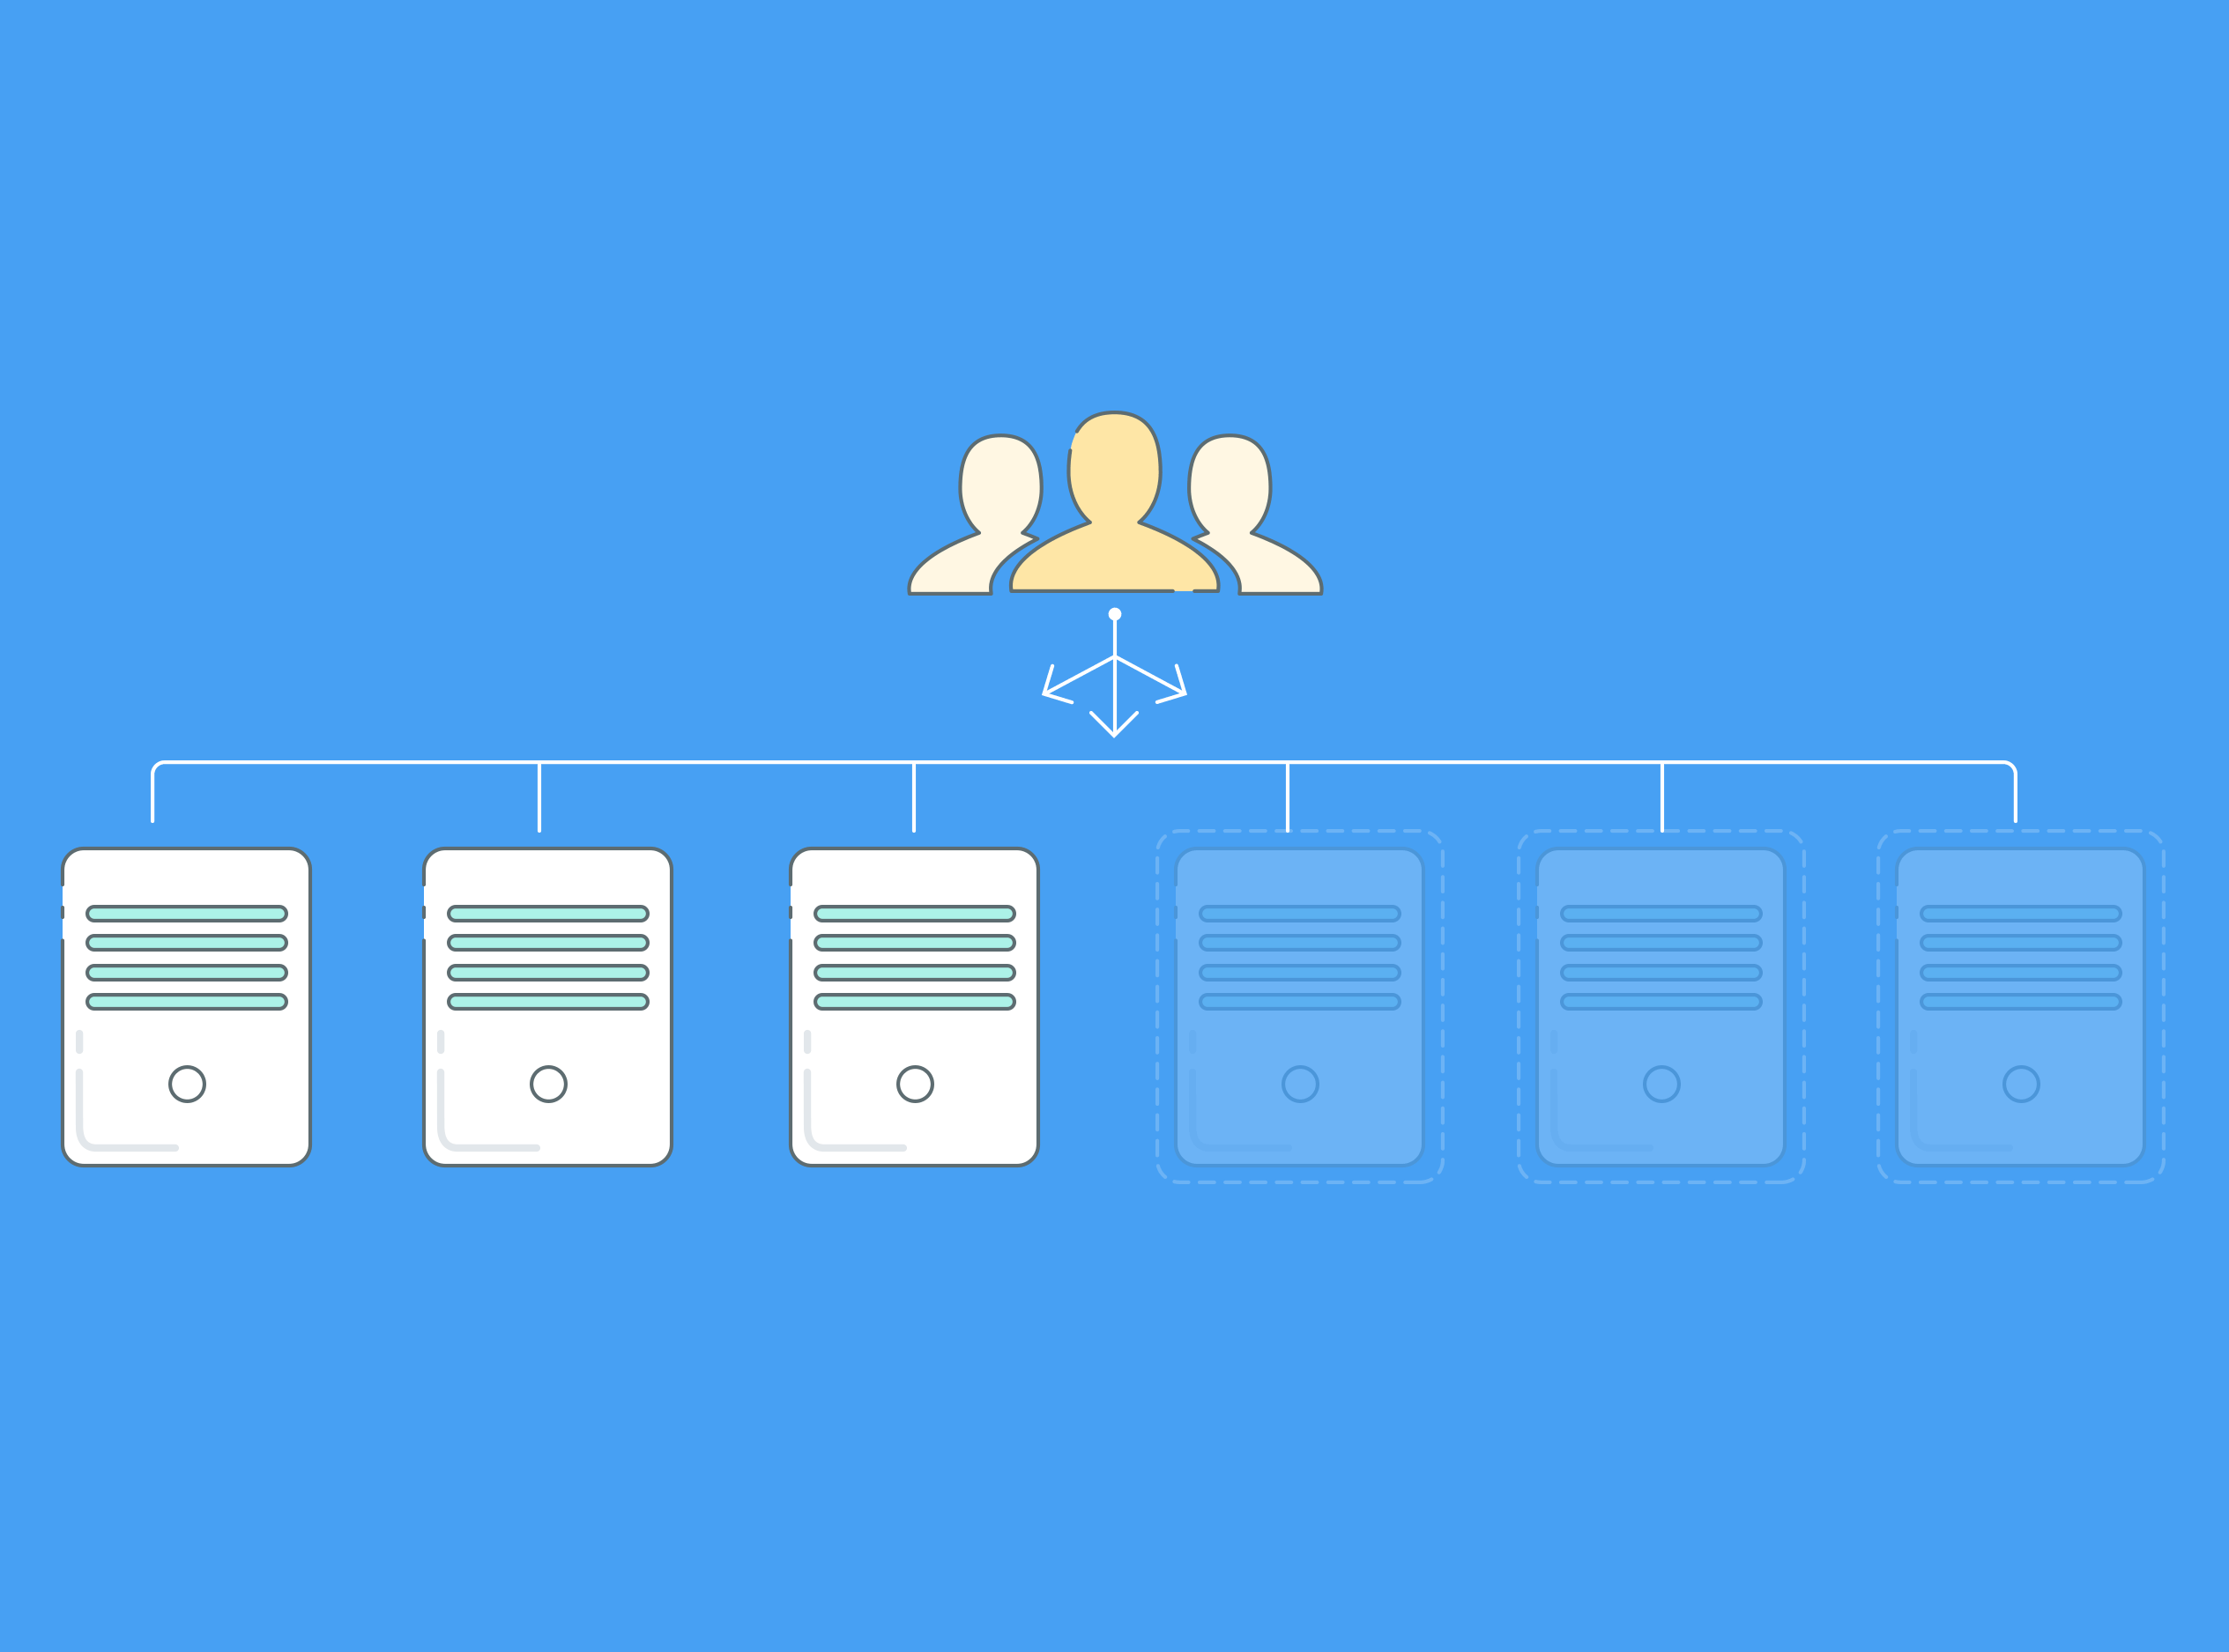
SCALING AND HIGH AVAILABILITY
Scalability ensures applications handle increasing loads.
Load balancing, auto-scaling, and HA architectures achieve scalability.
Cloud services like AWS Auto Scaling assist in automatic scaling.

Slide 57
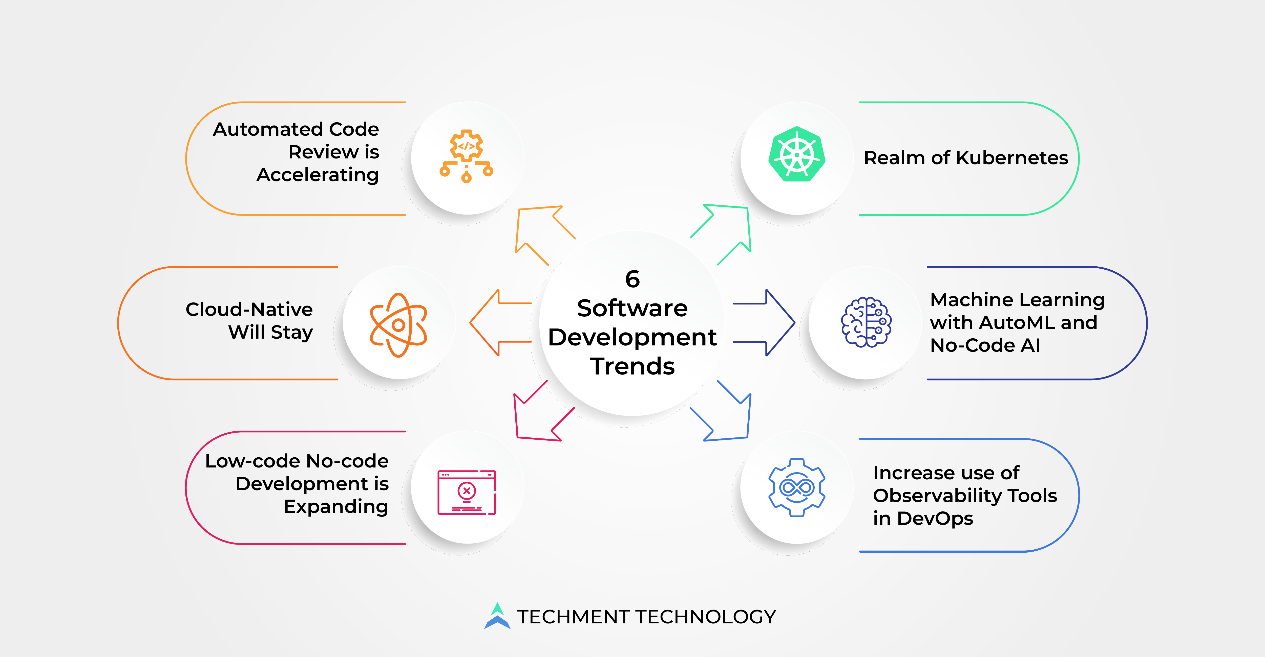
FUTURE TRENDS IN DEVOPS
Serverless computing offers event-driven, auto-scaling architectures.
AIOps leverages AI for IT operations automation.
DevOps evolves with emerging technologies for enhanced efficiency.

Slide 58

REFERENCE
www.geeksforgeeks.com
www.learn.Microsoft.com
www.techtarget.com
www.redhat.com
www.javatpoint.com
Learnings from Trainer

Slide 59
THANK YOU

